Slide 1









Data Visualisation: Human Resources
CASE STUDY
Client Challenge
Our Solution
Outcome
Client:
The client wanted to have an automated Human Resource Dashboard to track, analyze and report on HR KPIs.
The firm was looking for:
The company decided to use Infomineo’ Data Analytics service as a solution to cover:
The firm recognized that the quality of the Data Analytics service provided a useful reporting tool resulting in:
A multinational firm
Data Quality & Consistency problems between the various Data sources
Dashboard creation that reflects HR Team needs
During the project, Data were corrected in the ERPs :
Manual files were not used anymore
Data Quality improved by 55% for critical data elements
Effective and quick solution
“I was really impressed by the responsiveness of the team : they came up with a first and quite impressive dashboard proposition within only a couple of days. I also really appreciated the quality of the work; it was really helpful for us to identify the data cleansing needed in our ERP.”
─ Chief Human Capital Officer (Client)
Estimated 1 FTE from the HR department could be reallocated to other tasks
Helped the company to start its Data Transformation
Infomineo has been asked to work with client’s Finance Team to create another dashboard
Smooth integration with its existing ERPs
Lower cost than buying from a specialized company an HR Dashboard tool
Ad-hoc deliverables :
Dictionaries, Creation of Metadata, Data Quality on boarding

Slide 2
Sentiment Analysis: Candidate Experience
CASE STUDY
Client Challenge
Our Solution
Outcome
Client:
The client collects large amounts of candidates' feedback data during the recruitment process and was looking for ways to analyse these datasets based off on negative reviews on Glassdoor
The firm was looking for:
Infomineo’ s Data Analytics team addressed the client’s challenges by:
The analysis provided the client with a comprehensive overview of candidate sentiments, enabling them to identify areas of strength and areas for improvement in the recruitment process.
In addition, the results of the analysis enabled the client to re-evaluate its recruitment procedures and make data-driven decisions to improve the candidate experience at the global, regional, country and departmental level.
The results also helped the client develop new perspectives on the power of AI-powered tools in streamlining and enhancing the analysis of large datasets
A multinational firm
Conducted sentiment analysis using the state-of-the-art language model Roberta to analyze candidate feedback and extract the overall sentiment
Alternative ways to analyse candidate feedback as opposed to doing it manually
Utilized AI-powered text summarization through Open AI's GPT-3 to extract key insights from candidate comments, focusing on areas of concern such as discrimination and unprofessionalism and showing the specific comments.
Generate relevant insights from the analysed data to improve the candidate recruitment experience
Dashboard creation :
Allowing for easy filtering of feedback and candidate sentiment

Slide 3
Data Collection and Analysis: Automobile Practice
CASE STUDY
Client Challenge
Our Solution
Outcome
Client:
To aid analysis for projects in the automobile sector, the client needed to collect data from an e-commerce platform and analyse this data.
The firm was looking for an efficient :
Infomineo’ s Data Analytics delivered:
A full-fledged webscraping tool, operable through a user interface was delivered to the client.
The solution enabled the client to extract listings from the e-commerce platform, across all cities and categories, using specific keywords.
This data and the insights generated will then be used by the client when developing strategy propositions for corporate clients served by its automobile practice.
A leading strategy consulting company
An end-to-end solution using Python, wrapped in a Graphical User Interface (GUI) to improve user experience. In addition, the solution was delivered as a Pypi package
An efficient and effective way to regularly collect data from an e-commerce website which operates in Morocco
Using the data collected, generate relevant insights that are relevant to one of the client’s practice areas

Slide 4
Time Series Analysis: Real Estate
CASE STUDY
Client Challenge
Our Solution
Outcome
Thanks to the web app, in a few clicks, a price can be computed for any real estate asset, for forecasting or pricing, on any platform.
Client:
The client was looking for a tool which would allow them carry out an in-depth analysis of its portfolio assets, estimate real estate prices in their operating markets and assist in planning for potential investments.
The firm was looking for :
The company decided to use Infomineo’s Data Analytics service as a solution to cover:
A real estate investment company
Machine Learning algorithms
Using state delivered transactions as well as exogenous data
Before the project, senior executives in the company including the CEO relied on price estimates provided by an analyst which involved comparing prices across similar communities.
This approach was time-consuming, oftentimes inaccurate, and offered no trend analysis or provided forecasts
Informative and quick solution
Dashboard creation fast and high quality dashboarding
Fast computing and easy access
With a web app including dashboards
Ad-hoc deliverables :
Web App
in depth understanding of current market and on a particular asset
The firm recognized that the quality of the Data Analytics service provided a consistently useful tool and Infomineo also delivered a case study on a set of assets and provided real time updating of the solution.

Slide 5
Time Series Analysis: Retail Sales
CASE STUDY
Client Challenge
Our Solution
Outcome
Understand the properties of products and stores which play a key role in increasing sales, in order to get actionable recommendations for its sales teams
The firm was looking for :
Client:
The company decided to use Infomineo’s Data Analytics service as a solution to cover:
The firm recognized that the quality of the Data Analytics service provided a consistently useful tool resulting in:
A leading retail company with operations across the Middle East and North Africa
Machine Learning algorithms
Defining and deploying a precise and interpretable algorithm
Giving key indicators to the strategy team as well as valuable insights in the customer habits and preferences. The firm has benefited of data comprehension that allowed strategic decisions to be made.
Interpretable modelling
Allowing sales team to draw insights
Ad-hoc deliverables :
GUI and Python package with documentation
detailed end-to-end walkthrough, with assumptions and methodology
Easy deployment for regular use

Slide 6
Can Graphic Design help with graphics to highlight the process for each case? Or is this irrelevant and text alone will suffice?
Data Intake
Data Analysis and Defining Methodology
Data Preprocessing
Presentation with insights generated from the data
Modelling: Sentiment Analysis
Dashboard with insights generated delivered to the client and deployed at the global and departmental level

Slide 7
Time Series Analysis: Real Estate
xxx
Presentation
Asia
Europe
US
Africa
Middle East
Request
The project’s objective was to deliver a forecasting method of Dubai real estate market and compare “The Sustainable City” to its direct competitors.
Main challenges
Performing a relevant clustering and analysis of Dubai’s real estate projects, with 1M rows over 15 years.
Identifying time related trends in the market.
Estimate the price of any real estate asset located in Dubai with a precision emphasis.
Dubai doesn’t provide any detailed socio-demographic data; therefore, external features are only USD index, Dubai stock market index, oil&gaz index and AED Index.
Infomineo’s approach
Data cleaning, Data Vizualisation, feature engineering.
Using K-means clustering with elbow approach to determine the cluster where The Sustainable City is.
Perform statistical analysis of time series predictions for the TSC and its direct competitors.
Compute and fine tune time series algorithms : NPTS, Simple feed forward, ARIMA, SARIMAX, seasonal trends, Transformer …
Predict the price of any asset through Machine learning algorithms : tree based, neuronal networks, regressions …
Deliverable
A web-app for data visualization, mapping and price-prediction tools
A presentation to introduce the application and detail our work and our assumptions

Slide 8
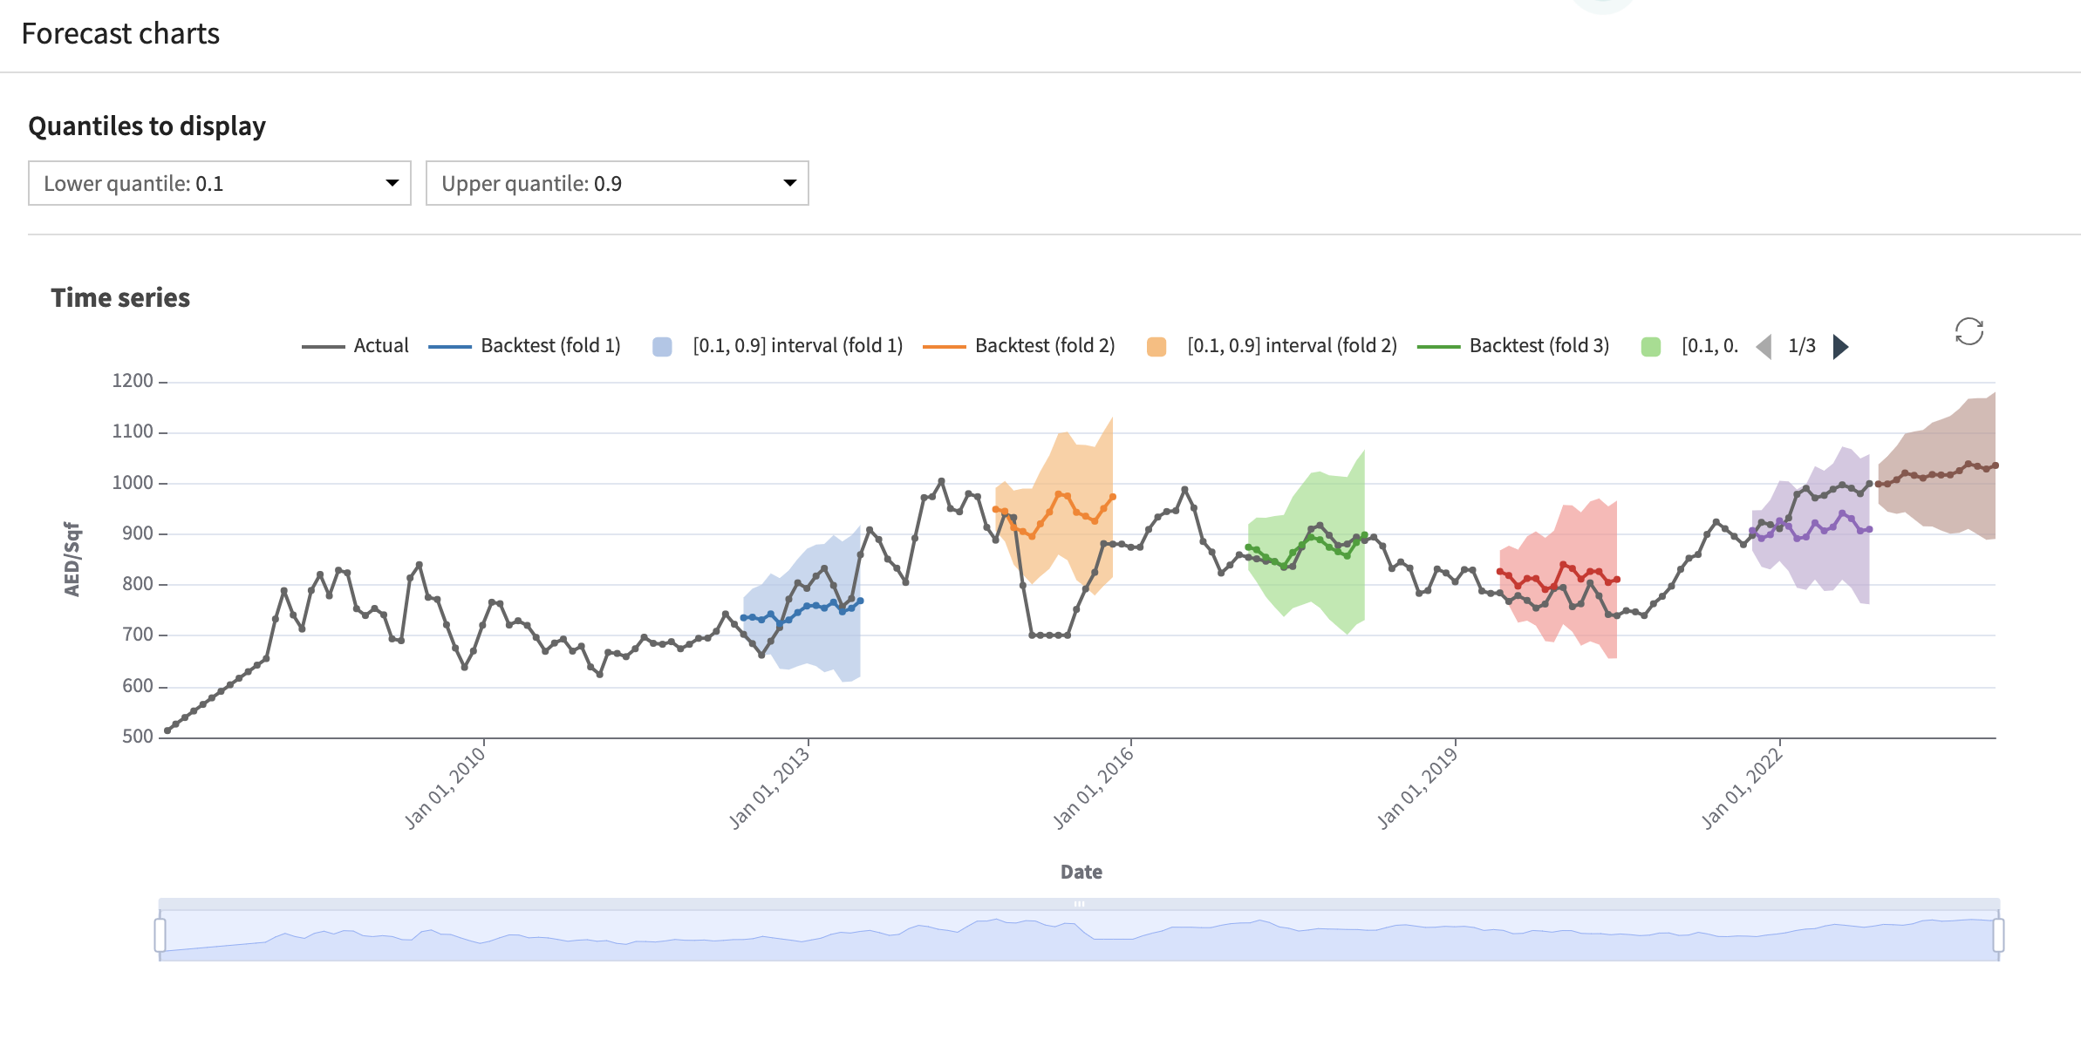
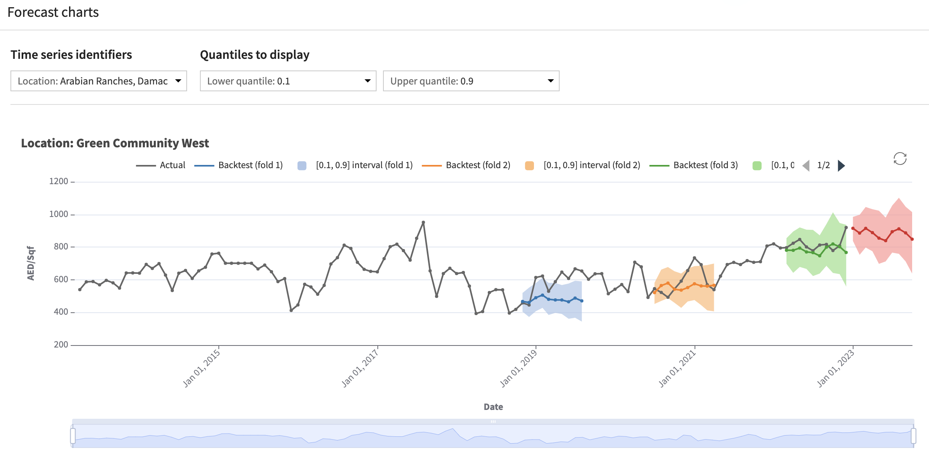
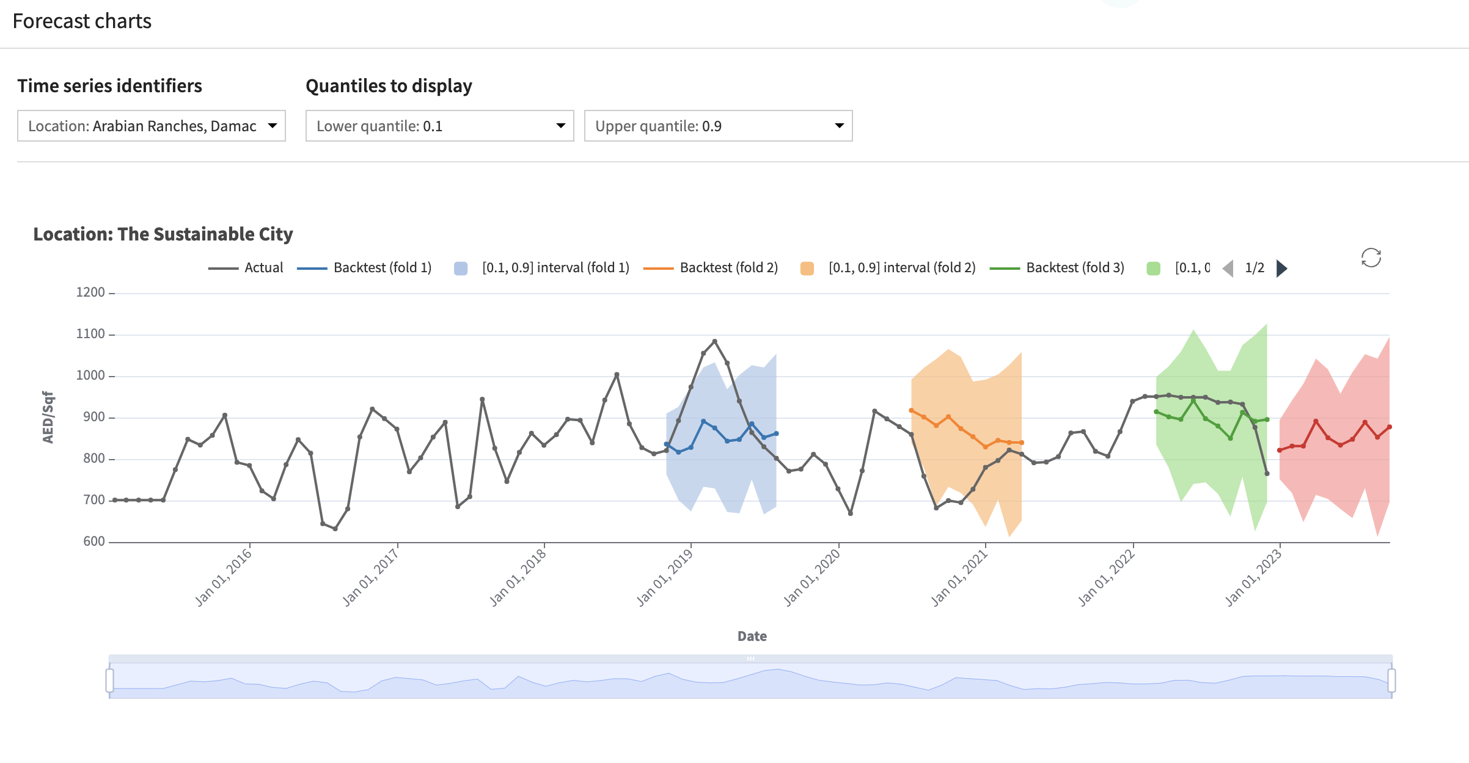
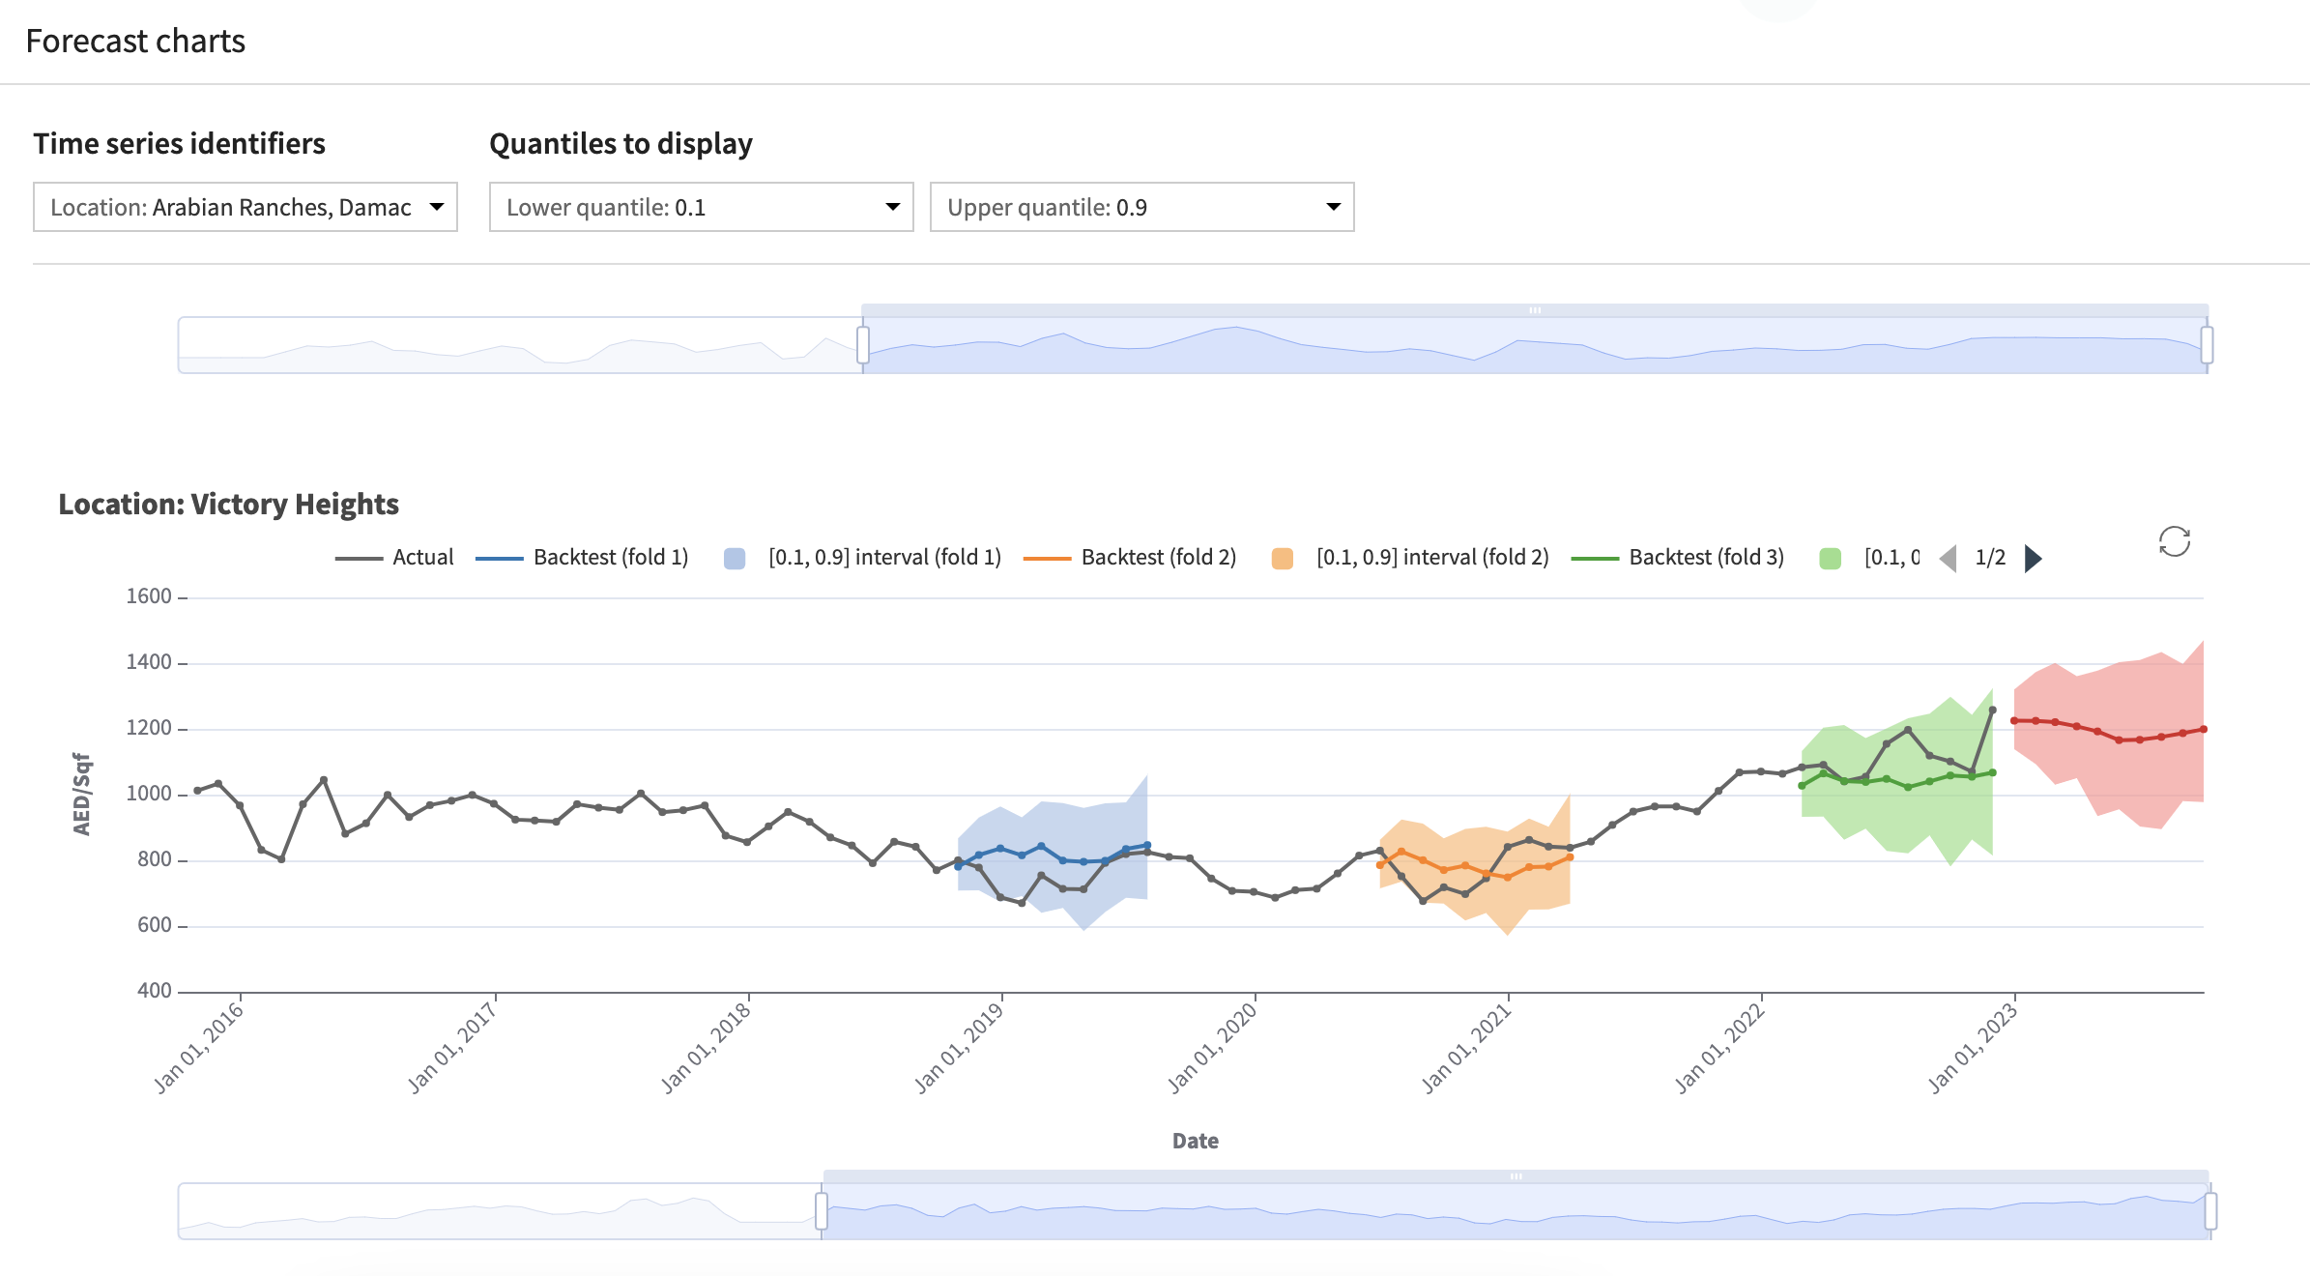
TIME SERIES ANALYSIS
Our data consist of all real estate transactions in Dubai for the last 15 years. We also added economic data such as the dollar index to track inflation, oil&gaz index, stock index …
Dubai real estate is separated in 3 main categories : apartments, villas and townhouses. Those are, most of the time, located in communities that are built and sold following phases. After clustering the data with K-means, The Sustainable City appeared to be a medium luxury community, with a target of foreign and young customers. TSC has mainly townhouses and villas, with a green and sustainable identity. 8 other communities are within the cluster and are similar and close to TSC.
We then analyzed our data by statistical tests, in particular : Durbin-Watson for autocorrelation, Kwiatkowski for non-stationarity, Zivot-Andrews for trend stationarity and Mann-Kendall for trend. Conclusions were that the only community of the cluster that follows an autocorrelated time series, non-flat, and having a highly increasing trend was The Sustainable City. The best performing time series model was neural networks scoring a 6% MAPE, a highly accurate forecasting according to literature. Below are displayed time series forecastings for the whole Dubai real estate market and for TSC as well as two comparative competitors.
Dubai all market
Green Community West
The Sustainable City
Victory Heights

Slide 9
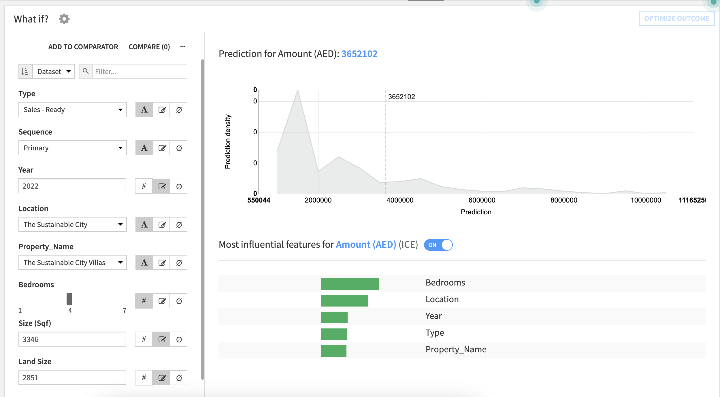
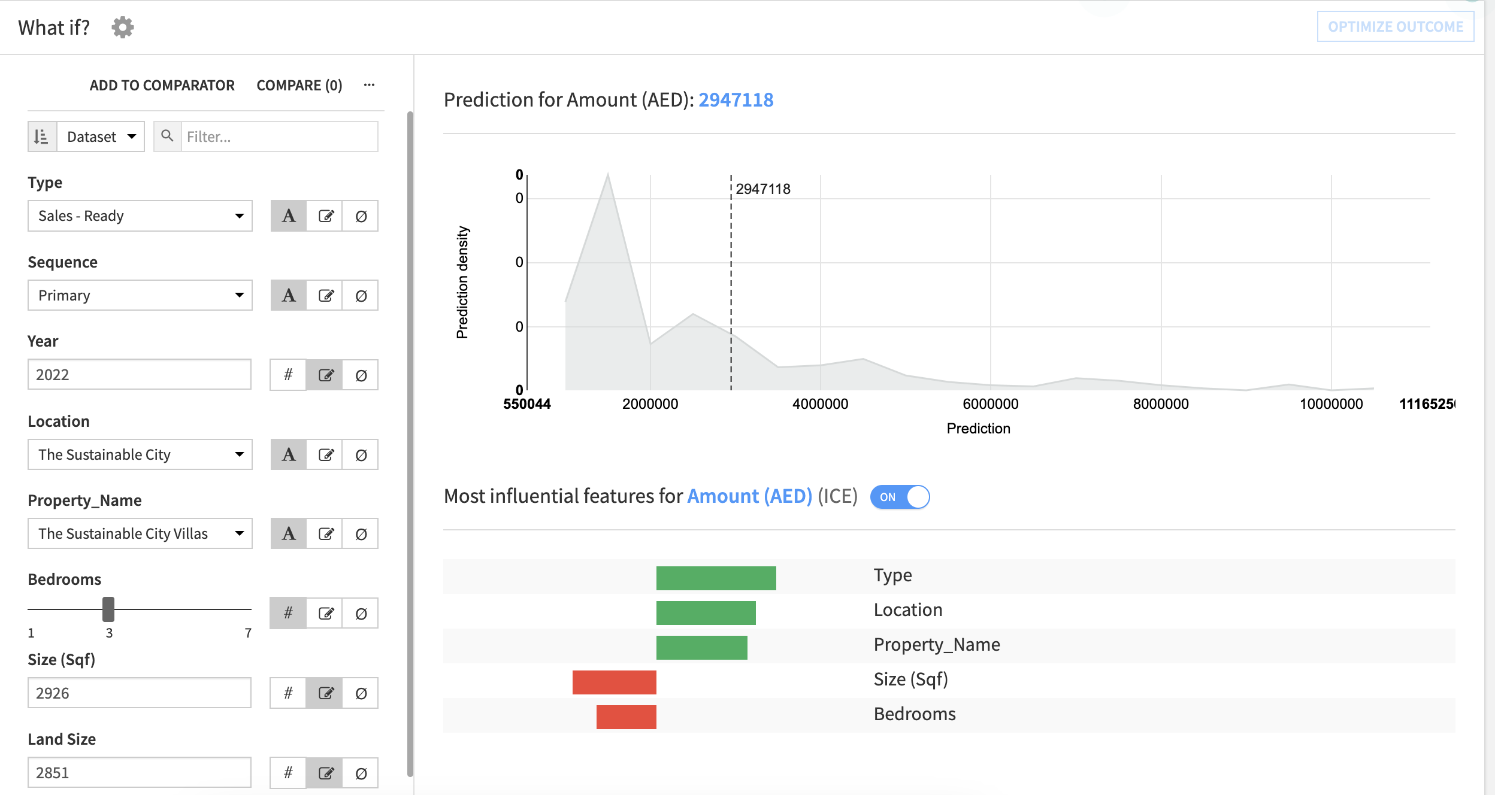
Price Estimation App
The web-app built in feature, allows the user to quicky evaluate the value of his asset or forecast it’s future value.
4 bedrooms in TSC
3 bedrooms in TSC
Optimization of gradient boosted trees with 247 trees of max depth 7 gave an R2 score of 0.9 and a MAPE of 15%. Those results are highly positive and informative and constitute a satisfying POC. However, in the future, it will need to be enriched with more exogenous and geospatial data, in order to reduce the Mean Average Percentage Error.

Slide 10
MART SALES PREDICTIONS
Introduction
Asia
Europe
US
Africa
Middle East
Request
Shopping centers such as malls and marts are usually recording sales as an important step to predict the activity and get an idea about future demands that can help, for example, with inventory management. The objective of this project is to understand what role certain properties of an item play and how they affect their sales. The data is listing sales of 1559 different products from 10 stores in different cities.
Main challenges
With a missing values, data needs to be accurately cleaned to keep enough information while not adding noise.
Data quantity is also a barrier since we only have 8K rows, we will need to put effort to achieve satisfying scores, in order to give relevant insights to our client.
Create a precise model that would retain good interpretability
Middle East
Infomineo’s approach
Conducting desk research leveraging different types of sources (by order of priority):
To build a predictive model that can find out the sales of each product at a particular store and then provide actionable recommendations to the cie sales team to understand the properties of products and stores which play a key role in increasing sales.
Checking Africa-focused Development banks and financial institutions project documents as they provide financial and technical assistance to countries implementing such programs
Countries local press to find insights on programs achievements and bottlenecks
Deliverable
We built a predictive model that can find out the sales of each product at a particular store and then provide actionable recommendations to the client’s sales team, in order to understand the properties of products and stores which play a key role in increasing sales.

Slide 11
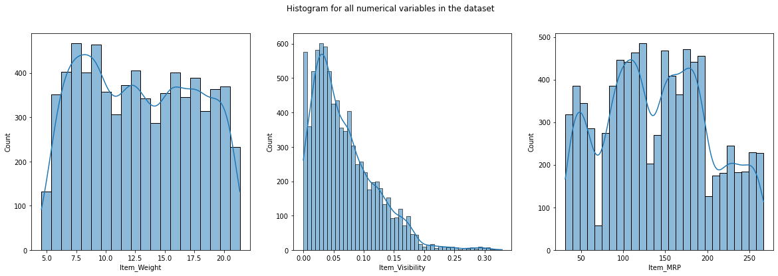
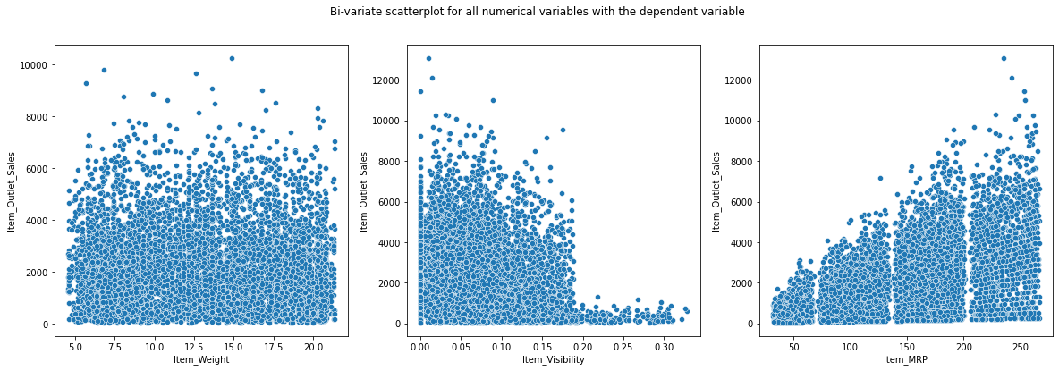
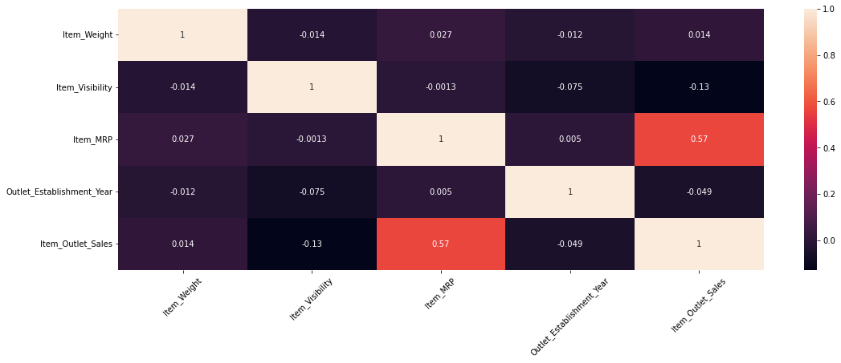
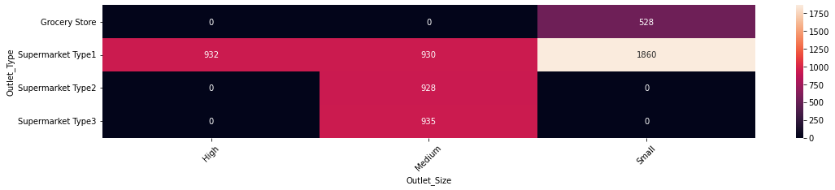
Analyzing and cleaning data
The training dataset we collected has 8523 observations and 10 columns. Item Weight and Outlet Size revealed substantial number of missing values, specifically outlet size that is an important feature. After understanding the business problem, the next step to follow is to have a better understanding of the dataset, i.e., what is the distribution of the variables, what are different relationships that exist between variables, etc. We will also treat anomalies like missing values or outliers. Part of this analysis is available in the below graphs:
Analyzing num. Variables
Bi-variate scatter plot
The variable Item_Weight is approx uniformly distributed and we will need to keep in mind when we will impute the missing values for this column, so we don't end up changing the distribution significantly after imputing. The variable Item_Visibility is a right-skewed distribution which means that there are more visible Items. The variable of products prices is following an approx multi-modal normal distribution.
The first scatter plot shows the data is completely random and there is no relationship between Item Weight and target. The second scatter plot between Item Visibility and target shows some kind of pattern, as the Item Visibility increases from 0.19, the sales decrease. This might be due to the management giving more visibility to those items which are not generally sold often. The third scatter plot is between the variables - Item_MRP and target. The variable Item_MRP will have a good predictive power to predict the sales.
Bi-variate Analysis for num. variables
Bi-variate analysis for cat. variables
We observe from the above heatmap that all the grocery stores have Outlet_Size as small.
All the Supermarket Type 2 and Supermarket Type 3 have Outlet_Size as Medium.
This informations are used to impute missing values for Outlet_Size.
it seems that only the independent variable Item_MRP has a moderate linear relationship with the target Item_Outlet_Sales.
There is no co-linearity between features.

Slide 12
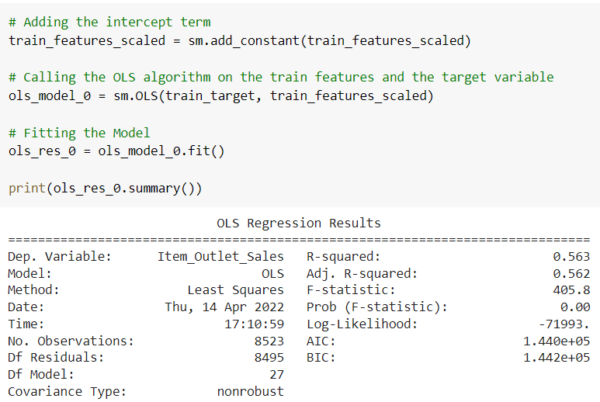
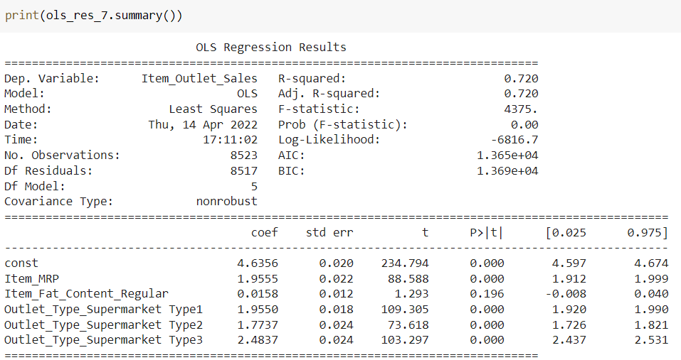
Modelling linear regression
During the modelling analysis, it is crucial to remove multi-collinearity and to keep only the relevant features. Linear regressions also need to satisfy four major assumptions that we will study to have the most accurate mathematical model.
Baseline regression model
Final regression model
Through multiple iterations, we removed multicollinearity of features using Variance Inflation Factor and removed low importance features with P-values.
We then checked the four different assumptions of linear regression and fixed the model iteratively:
Mean of residuals should be 0
Normality of error terms
Linearity of variables
No heteroscedasticity
Computed weights allowed the strategy team to make decision on future products and stores to prioritize.

